Slide 1
European Exploration of the americas

Slide 2
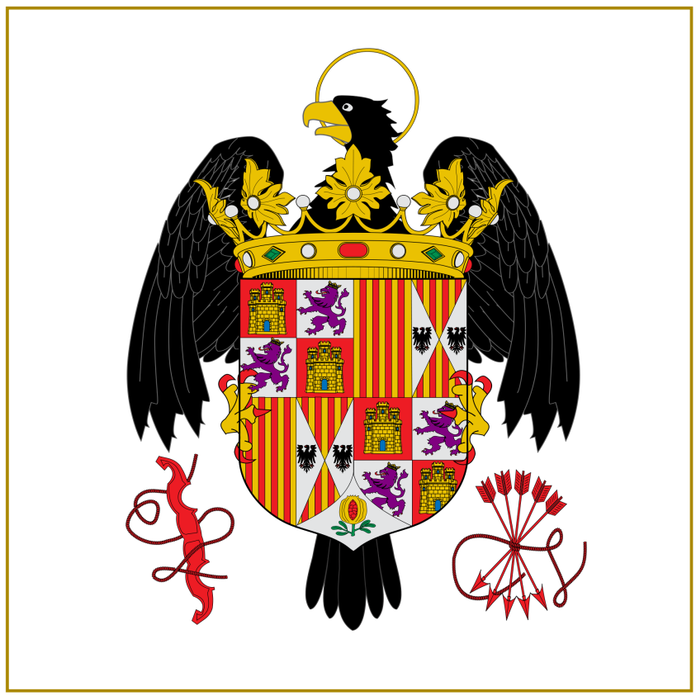
Spanish Conquistadores
By the 1500s, Spain is the dominant power in the New World.
“Dios, Oro, Gloria”
(Not necessarily in that order)
(1513) Vasco Nunez Balboa reaches the Pacific Ocean
(1519) Cortes vs. the Aztecs
(1519-1522) Ferdinand Magellan
Jeopardy! Training
(1531-1533) Francisco Pizarro vs. the Incas

Slide 3
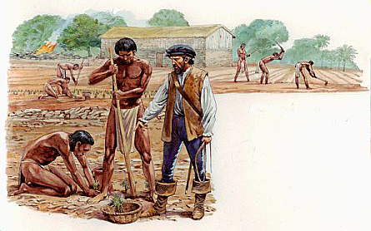
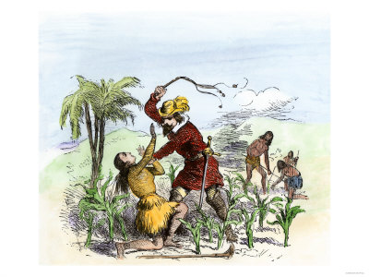
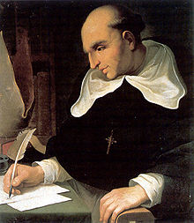
Economic Change & the Encomienda System
The Encomienda System
Natives “commended” (given) to Spanish landlords
Landlords theoretically tried to convert to Christianity
Pretty much just slavery.
Bartolomé de las Casas described it as “a moral pestilence invented by Satan.”
Plundered gold and silver makes Spain very rich.
Spain as engine for world economic growth.
Did I say world? I meant European.
West Indies as Staging Ground.

Slide 4
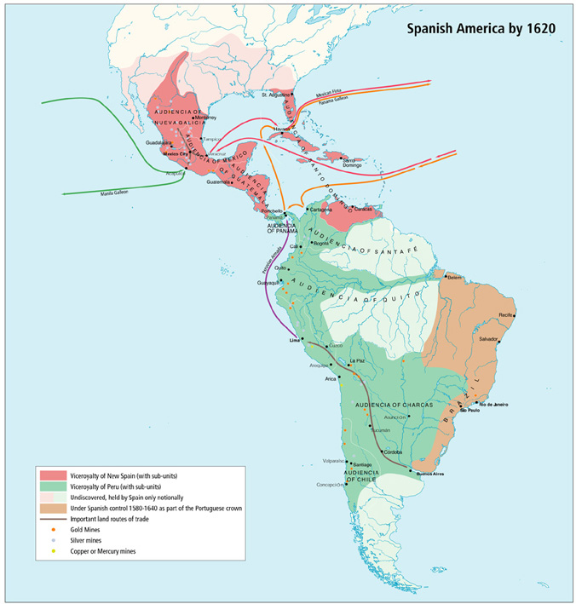
The Spanish Empire Spreads
Within 50 years of Columbus, 160,000 Spanish living in the Americas.
Population growth in Europe & Africa thanks to introduction of new foods. (Non-Meat Protein!)
100s of towns and cities, many quite large.
Natives in SW N. America resist for 50 years.
Claims of newly exploring nations (England, France) begin to bump against Spanish claims in mostly unknown North America.

Slide 5
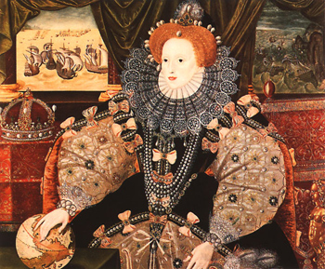
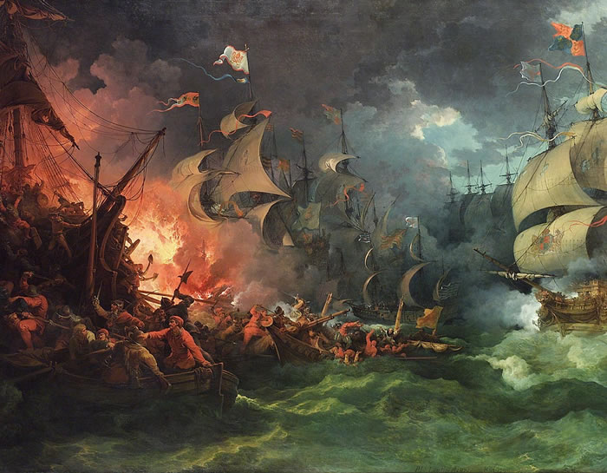
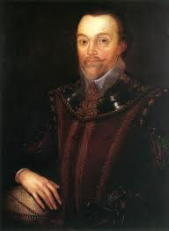
England Gets in the Game
England vs. Spain
King Henry VIII breaks from the Catholic Church, turning Catholic Spain from ally to enemy.
Ireland, occupied by England, remains Catholic and resistance to English rule grows.
Protestant English monarchs seize Church lands and further subjugate the Irish, becoming quite wealthy.
Queen Elizabeth encourages English “sea dogs” (such as Francis Drake) in their raids on Spanish holdings and ships in the 1580s.
England tries and fails to start a colony at Roanoke (1585).
Spain finally attacks England in 1588 by sea.
The Spanish Armada is wiped out by a mixture of tactics and nature.
England’s Star Ascendant

Slide 6
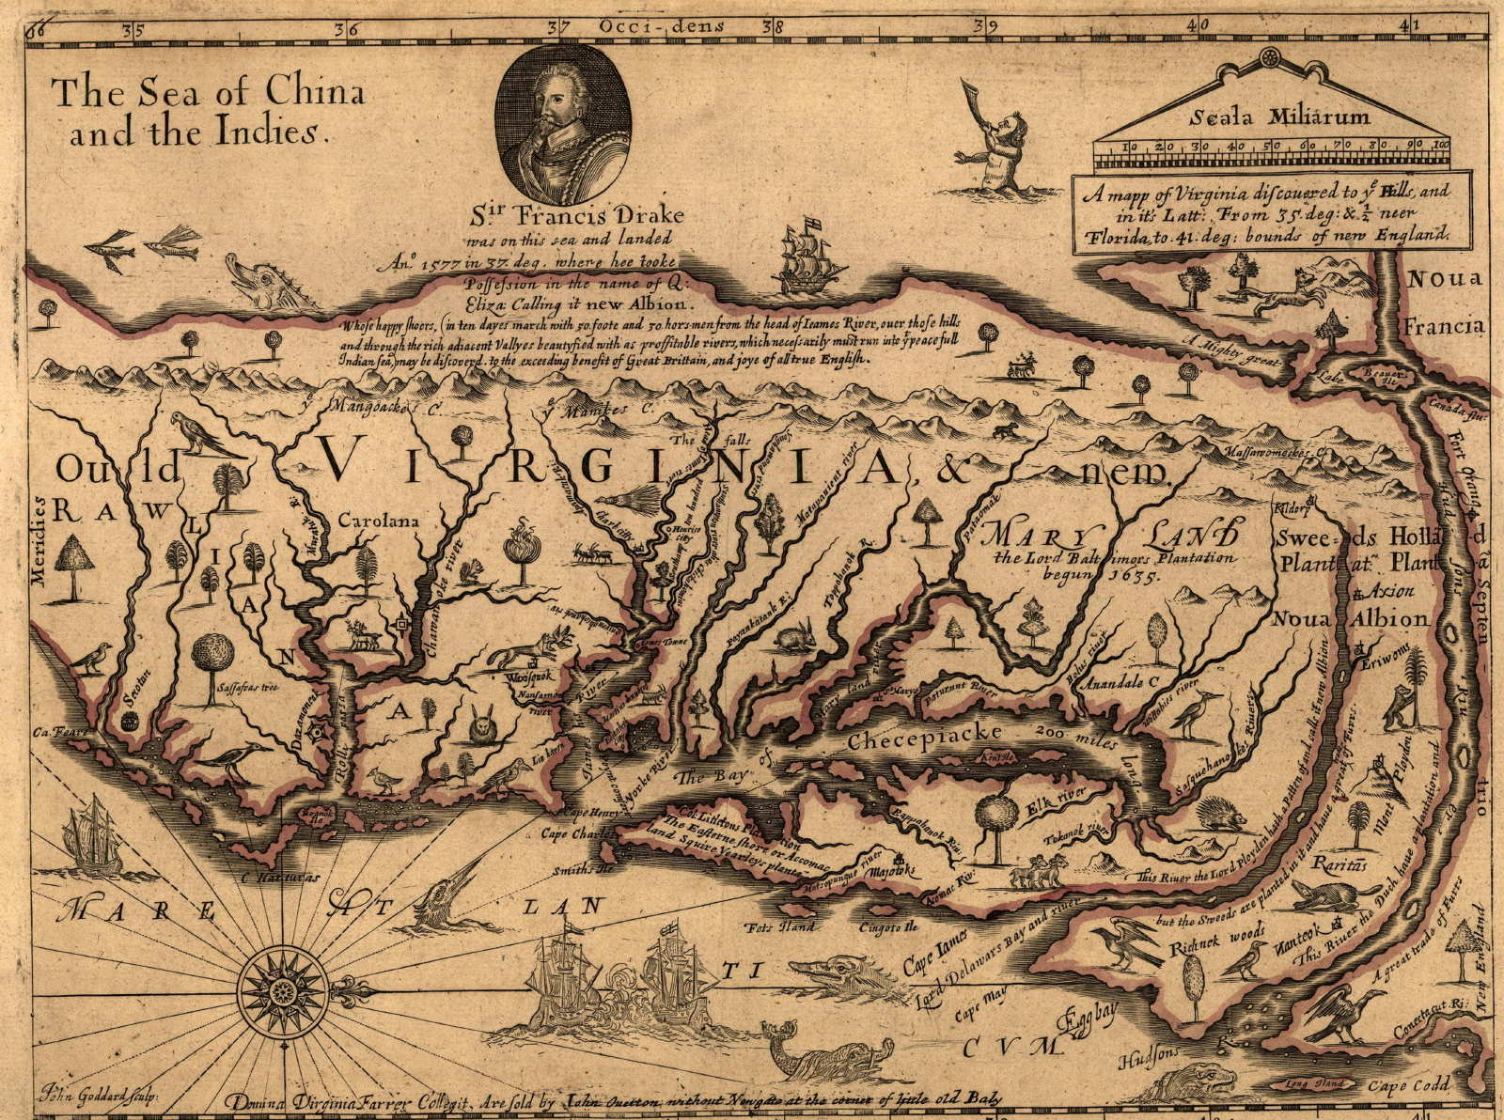
England’s Star on the Rise
Population grows from 3 to 4 million between 1550 and 1600.
Land management causing problems in England
Landowners turning land from agriculture to grazing
Unemployed farmers fill the cities
Laws of Primogeniture (Inheritance) only allow one son to inherit lands.
2nd and 3rd sons have no livelihood.
Investors pool resources into joint-stock companies.
The Virginia Company formed in 1606, chartered by King James I
Charter grants colonists in North America the “rights of Englishmen.”

